Slide 1
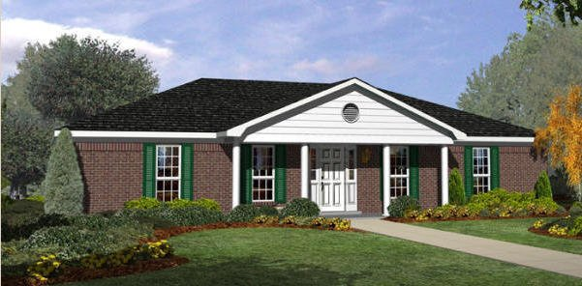


Jacqueline Majumder and city of mobile
2645 Greenback Drive

